Slide 1
Journal Club
Jack McDonnell
April 7, 2020

Slide 2
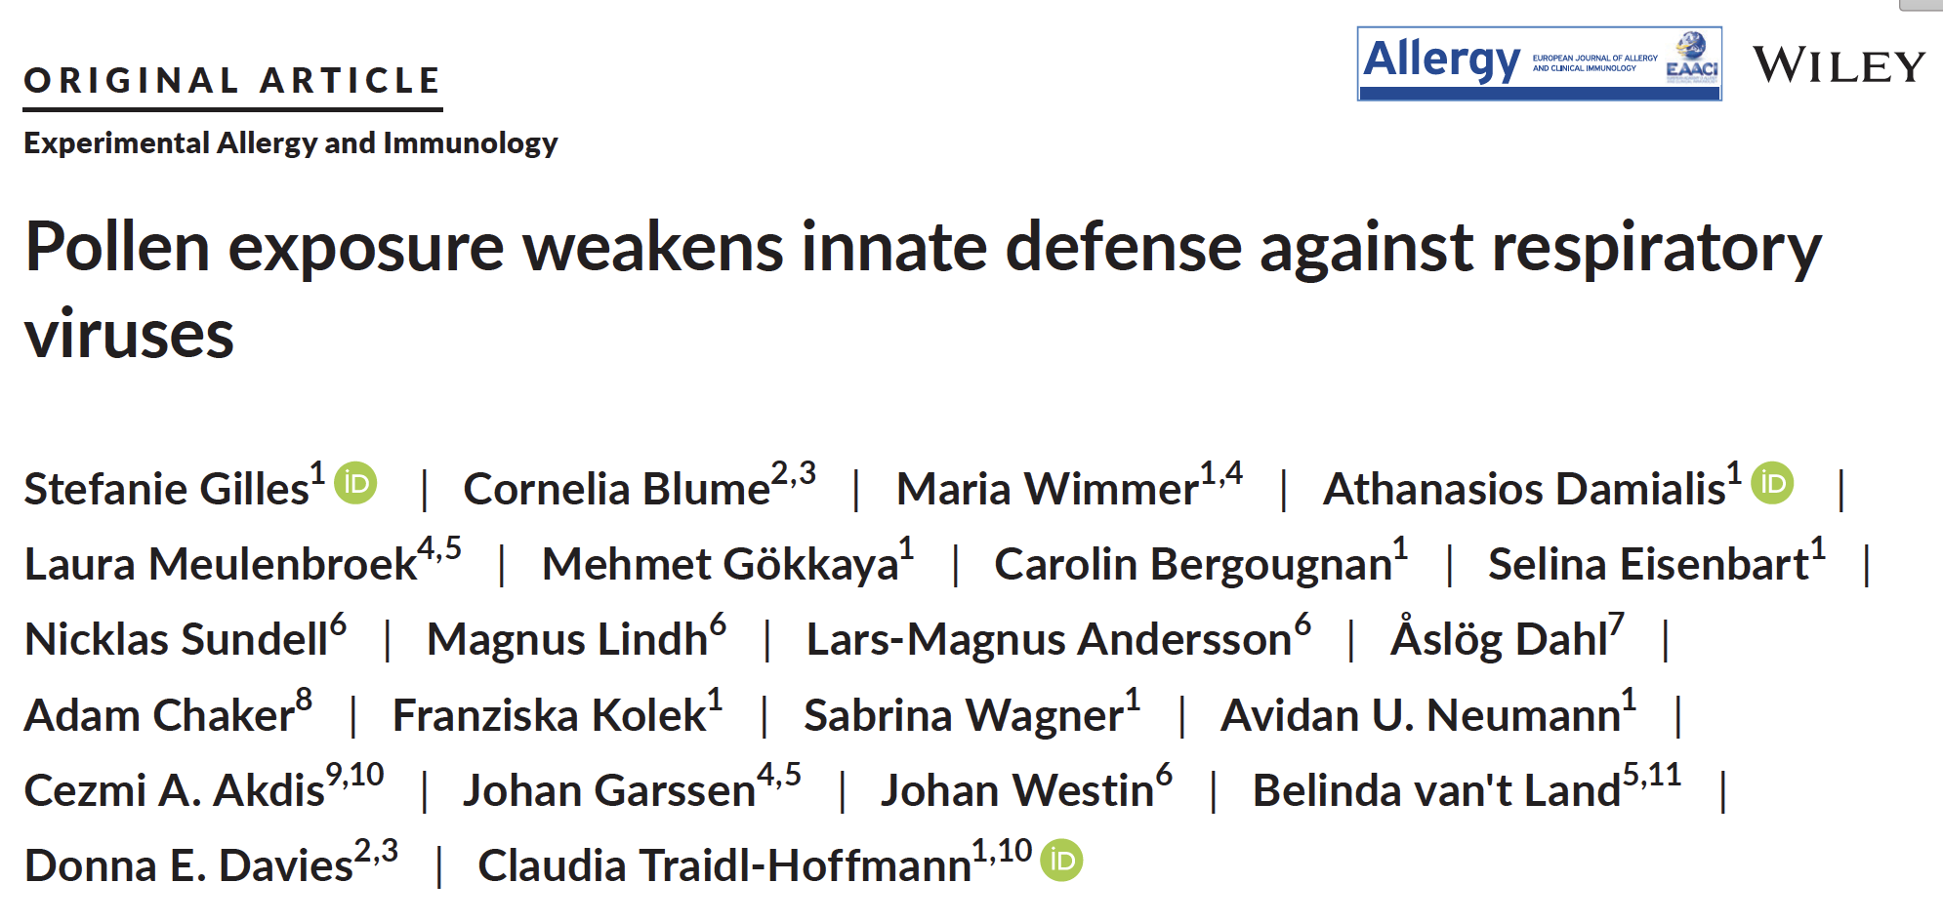

Slide 3

First . . . a brief tangent – some thoughts on reading scientific literature

Slide 4
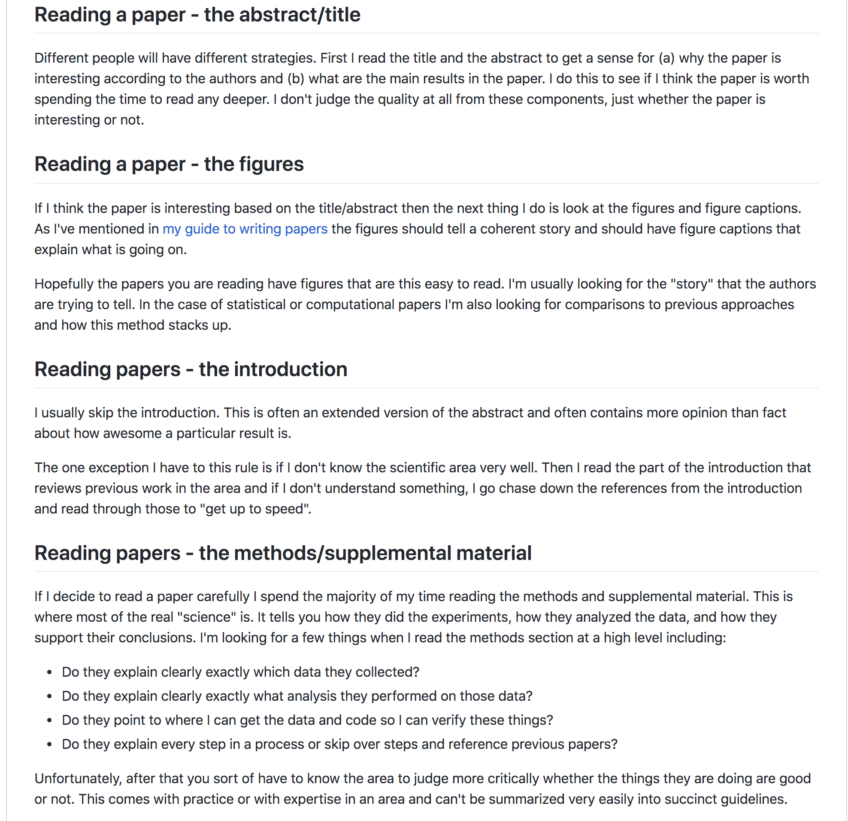

Slide 5
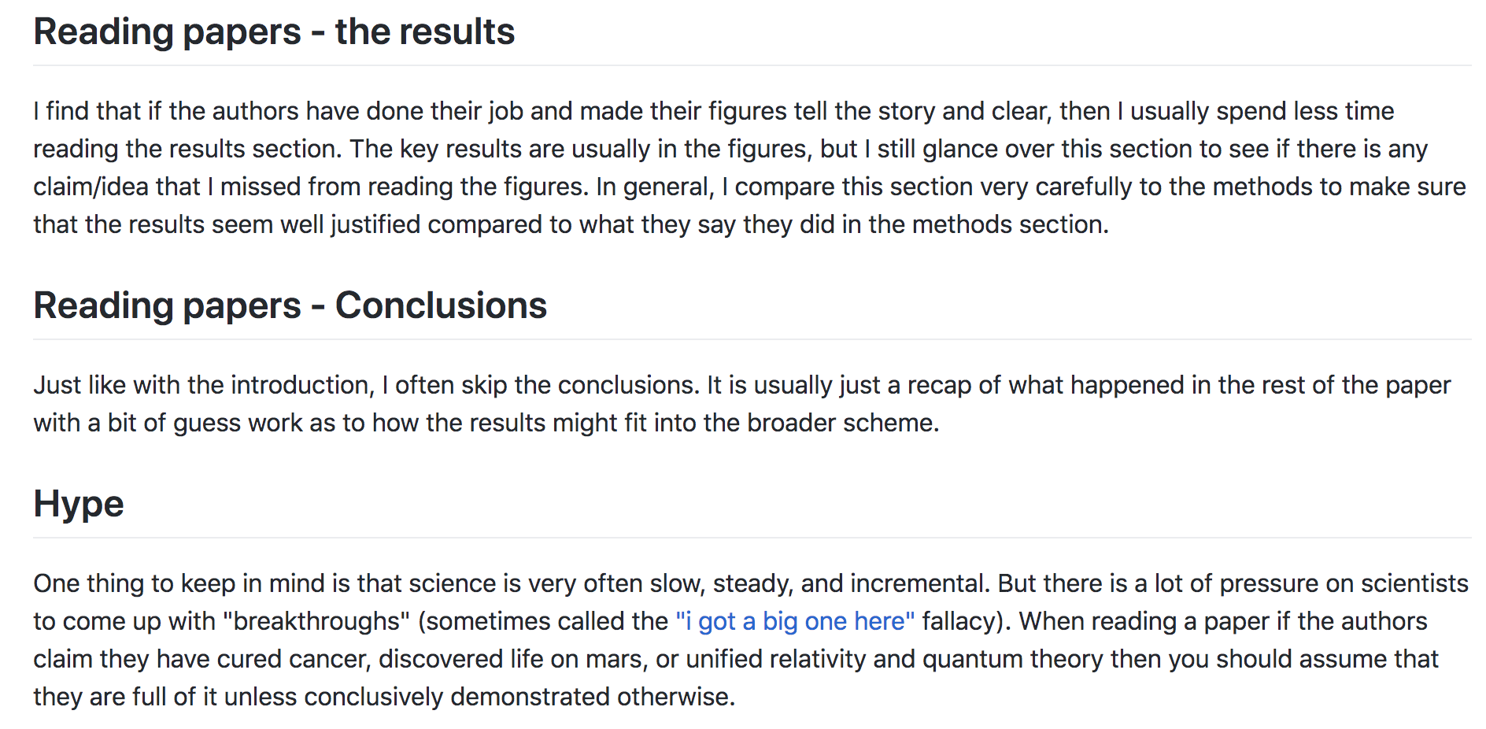

Slide 6
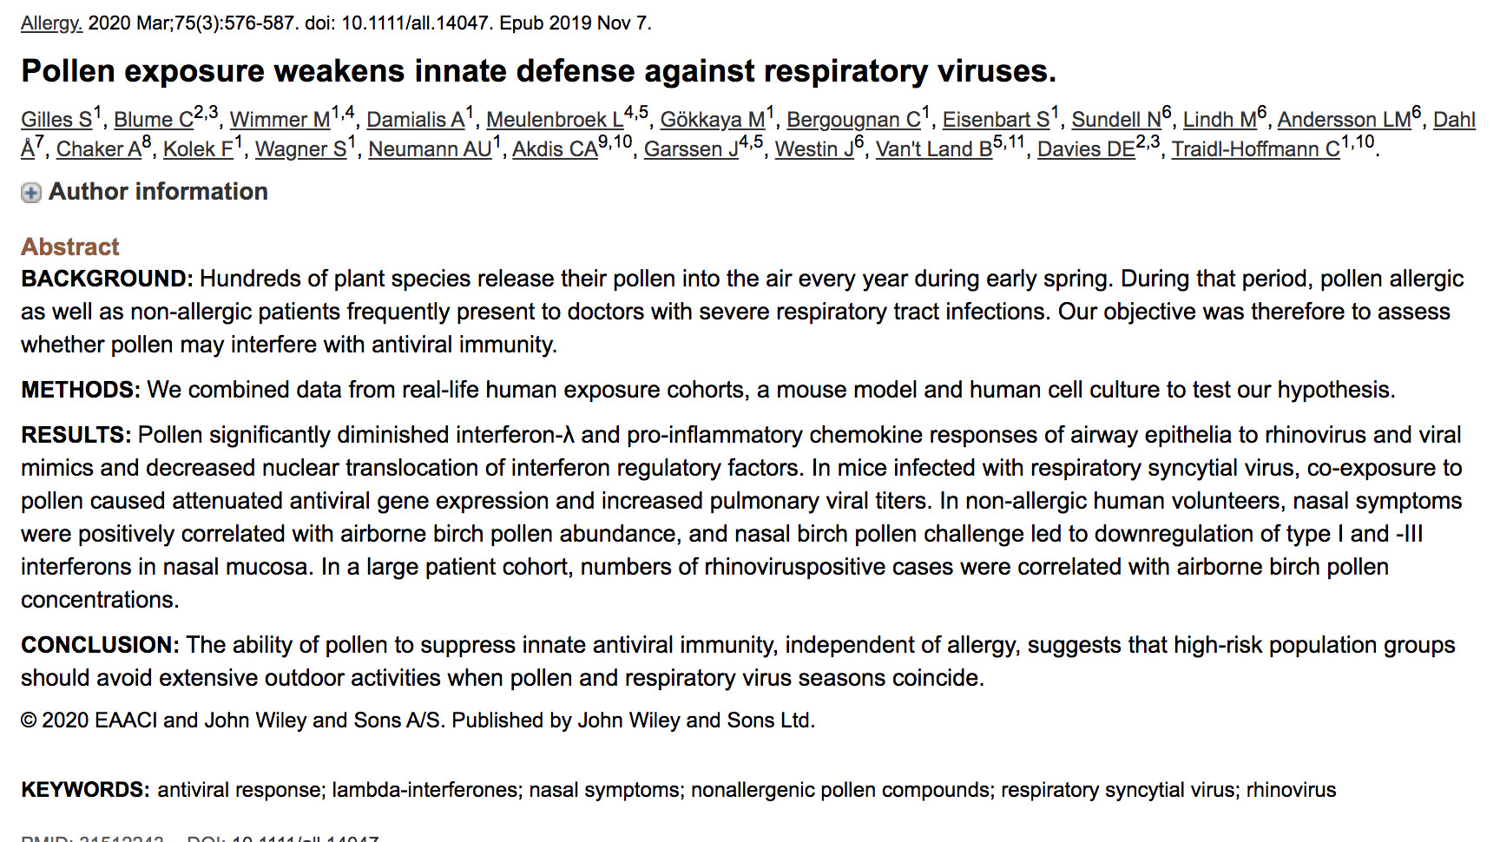

Slide 7
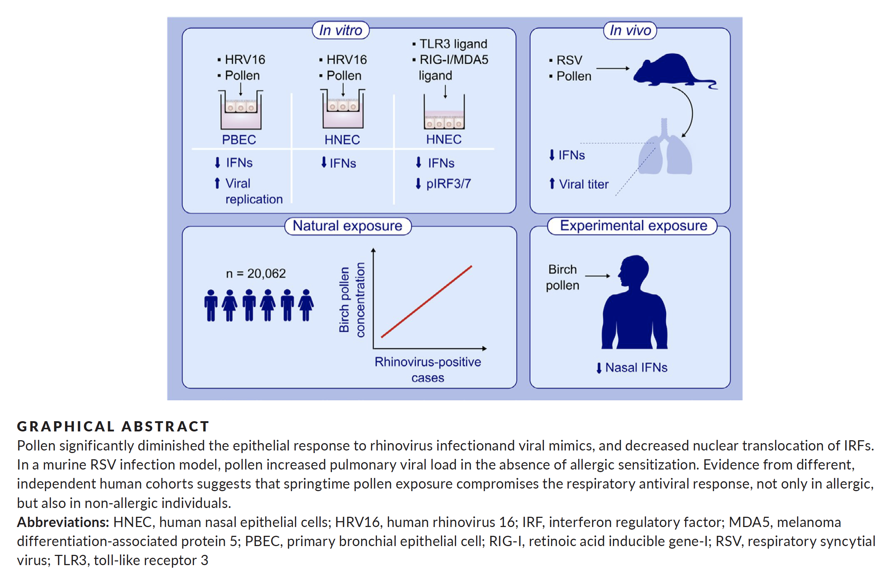

Slide 8
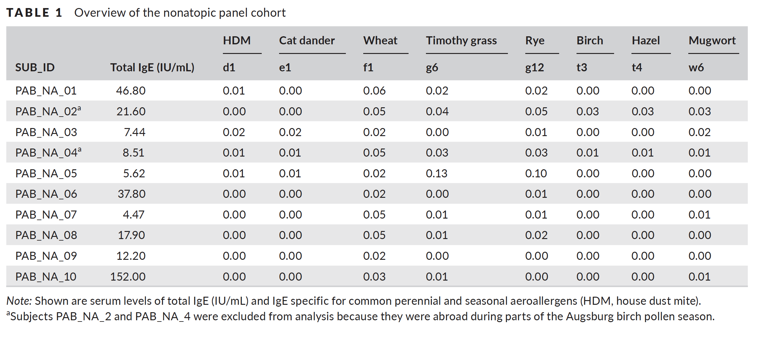

Slide 9
Human cells – in vitro

Slide 10
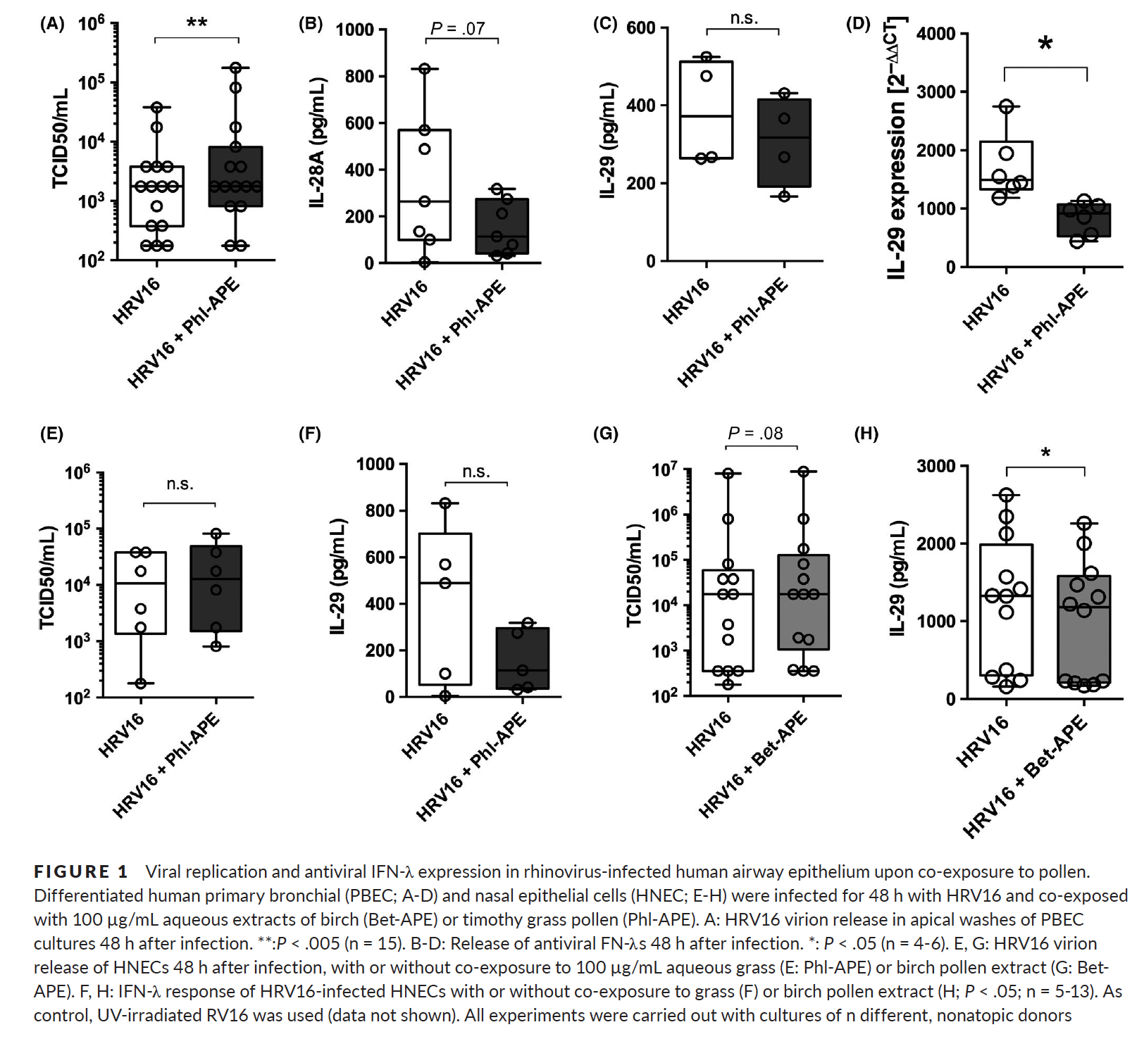

Slide 11
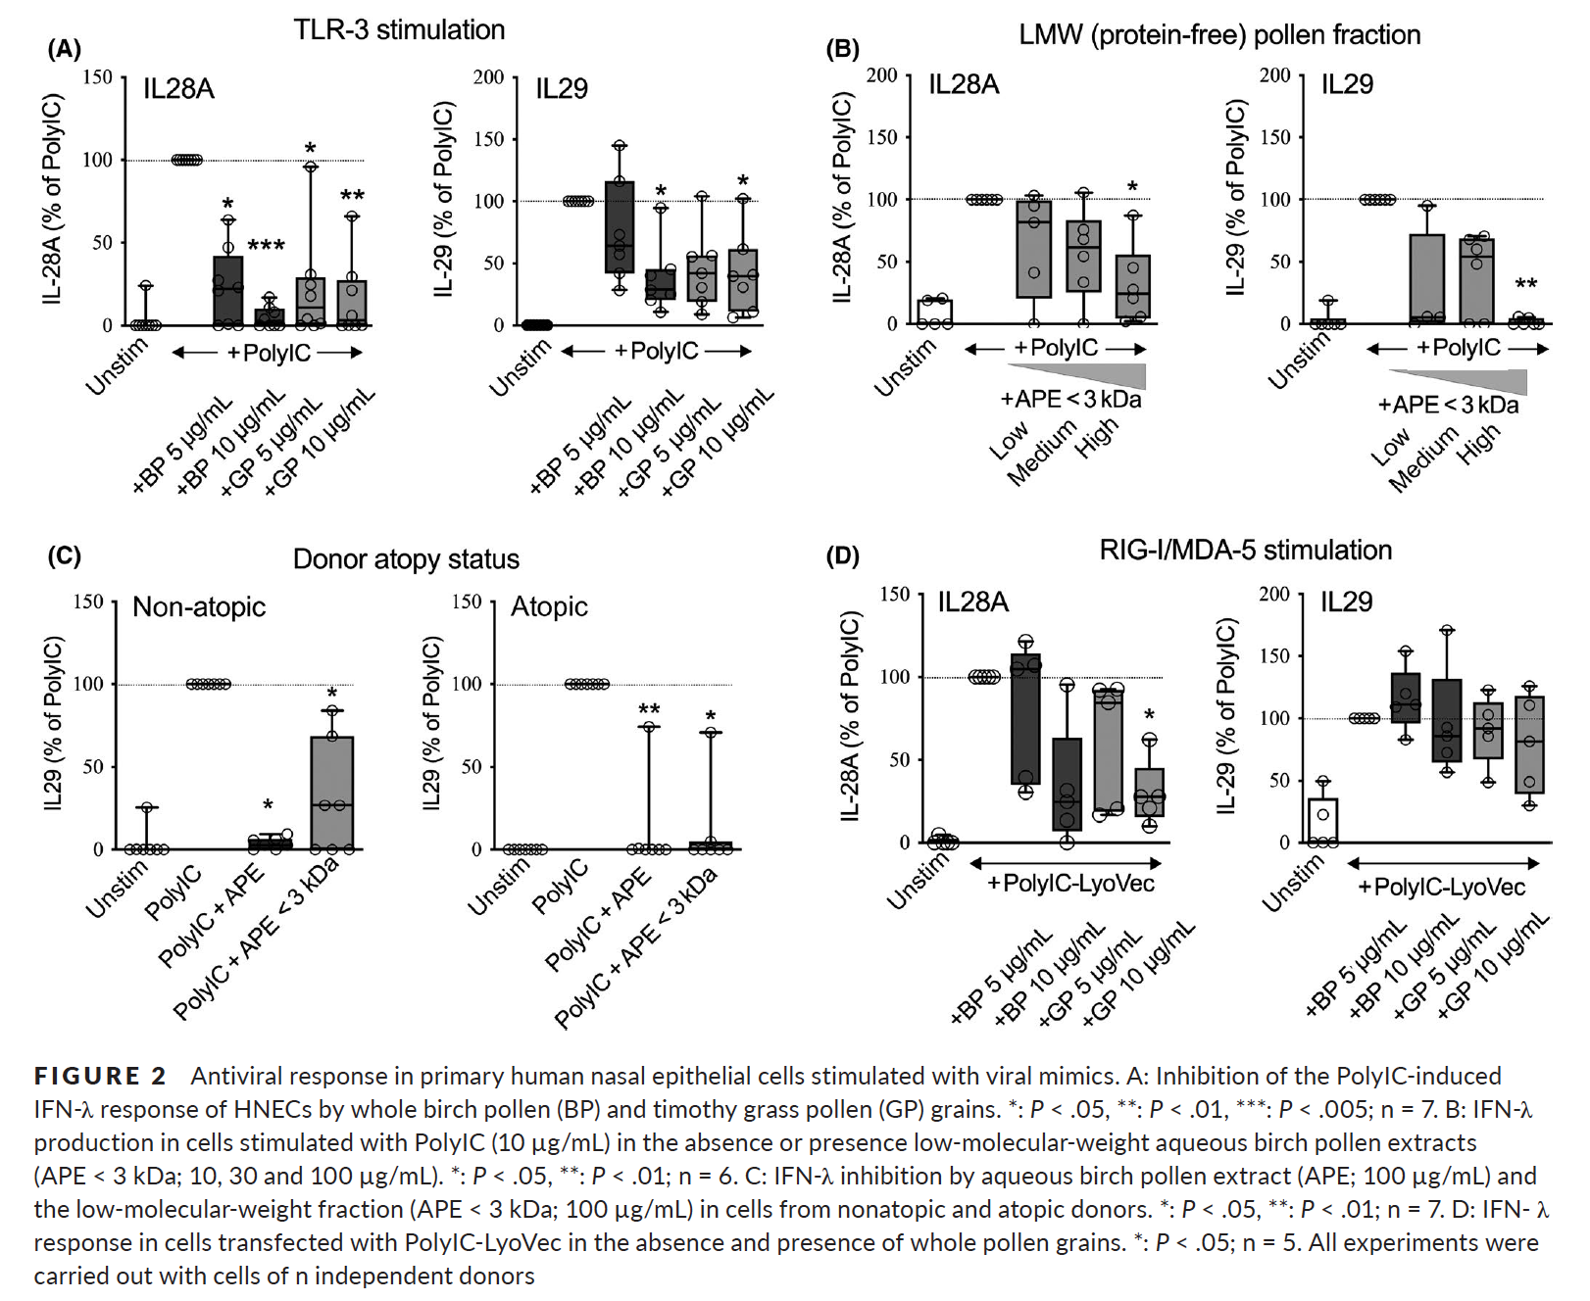
N = 7?

Slide 12
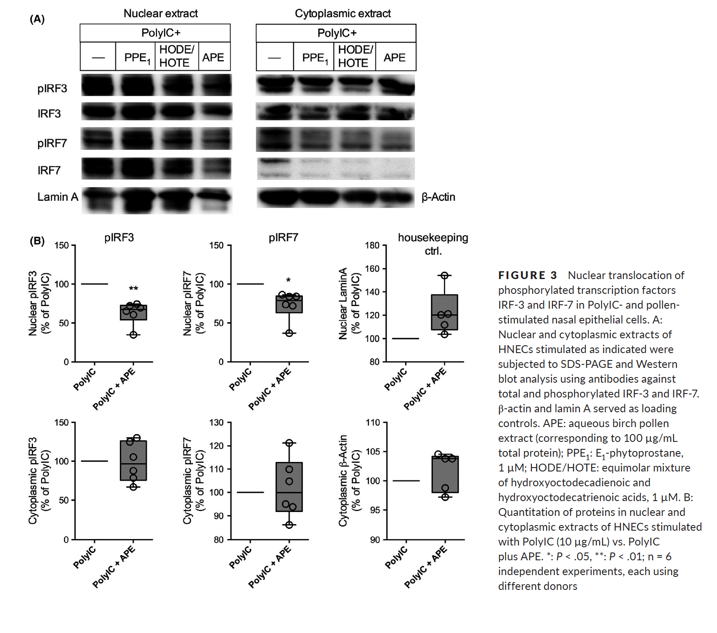

Slide 13
Murine in vivo

Slide 14
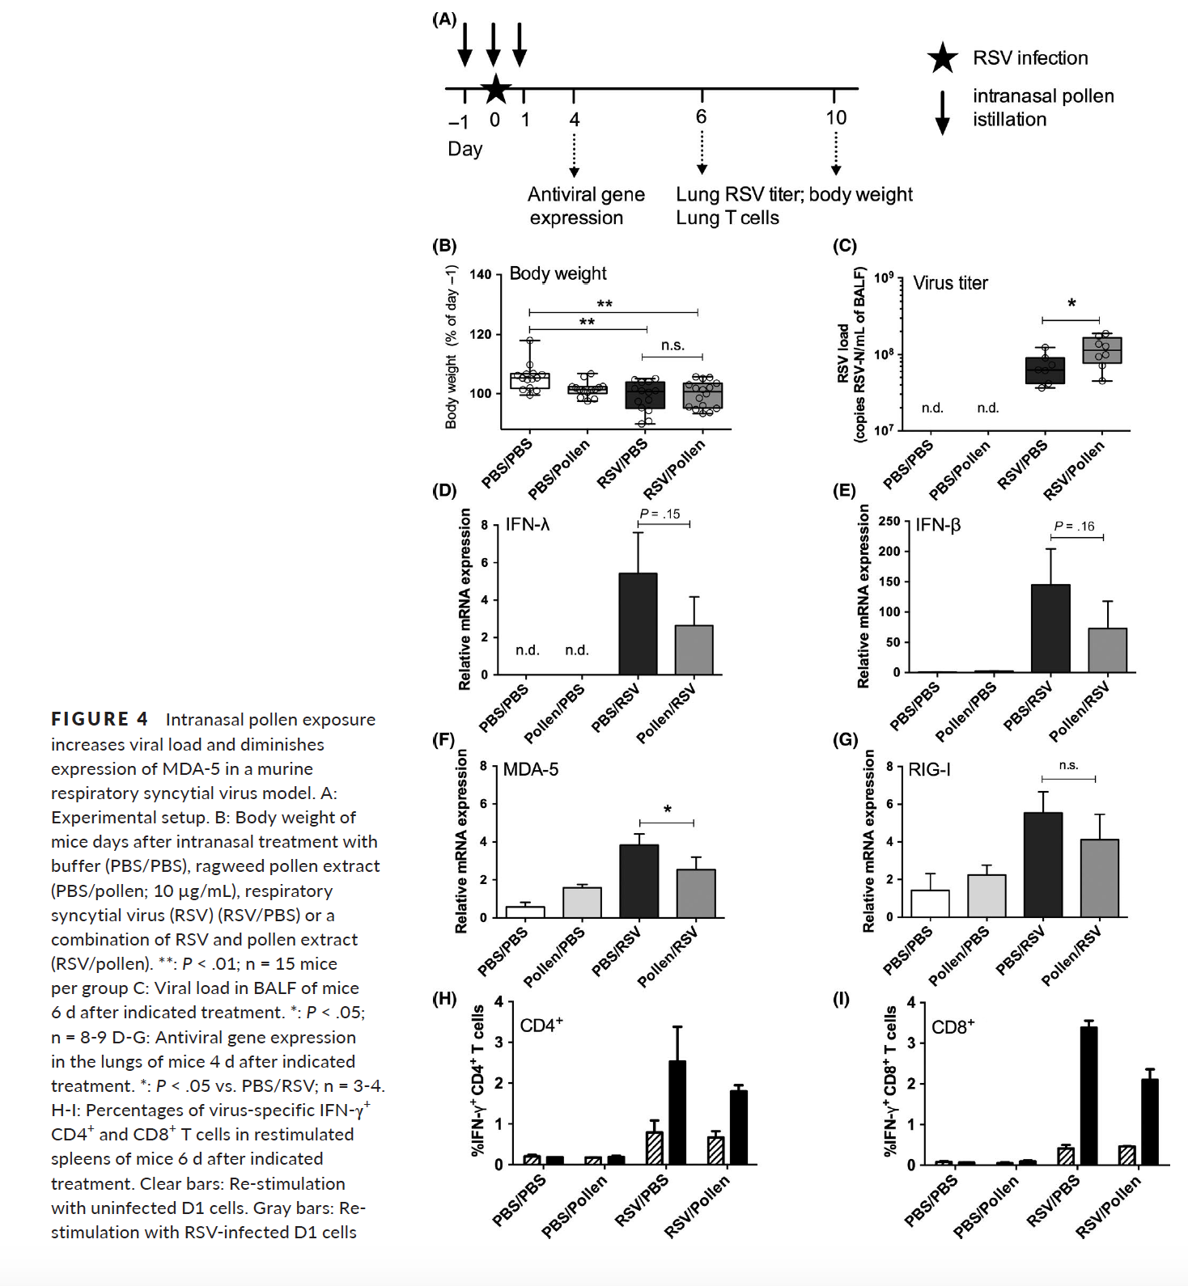

Slide 15
Human in vivo
Actually, 3 separate studies

Slide 16
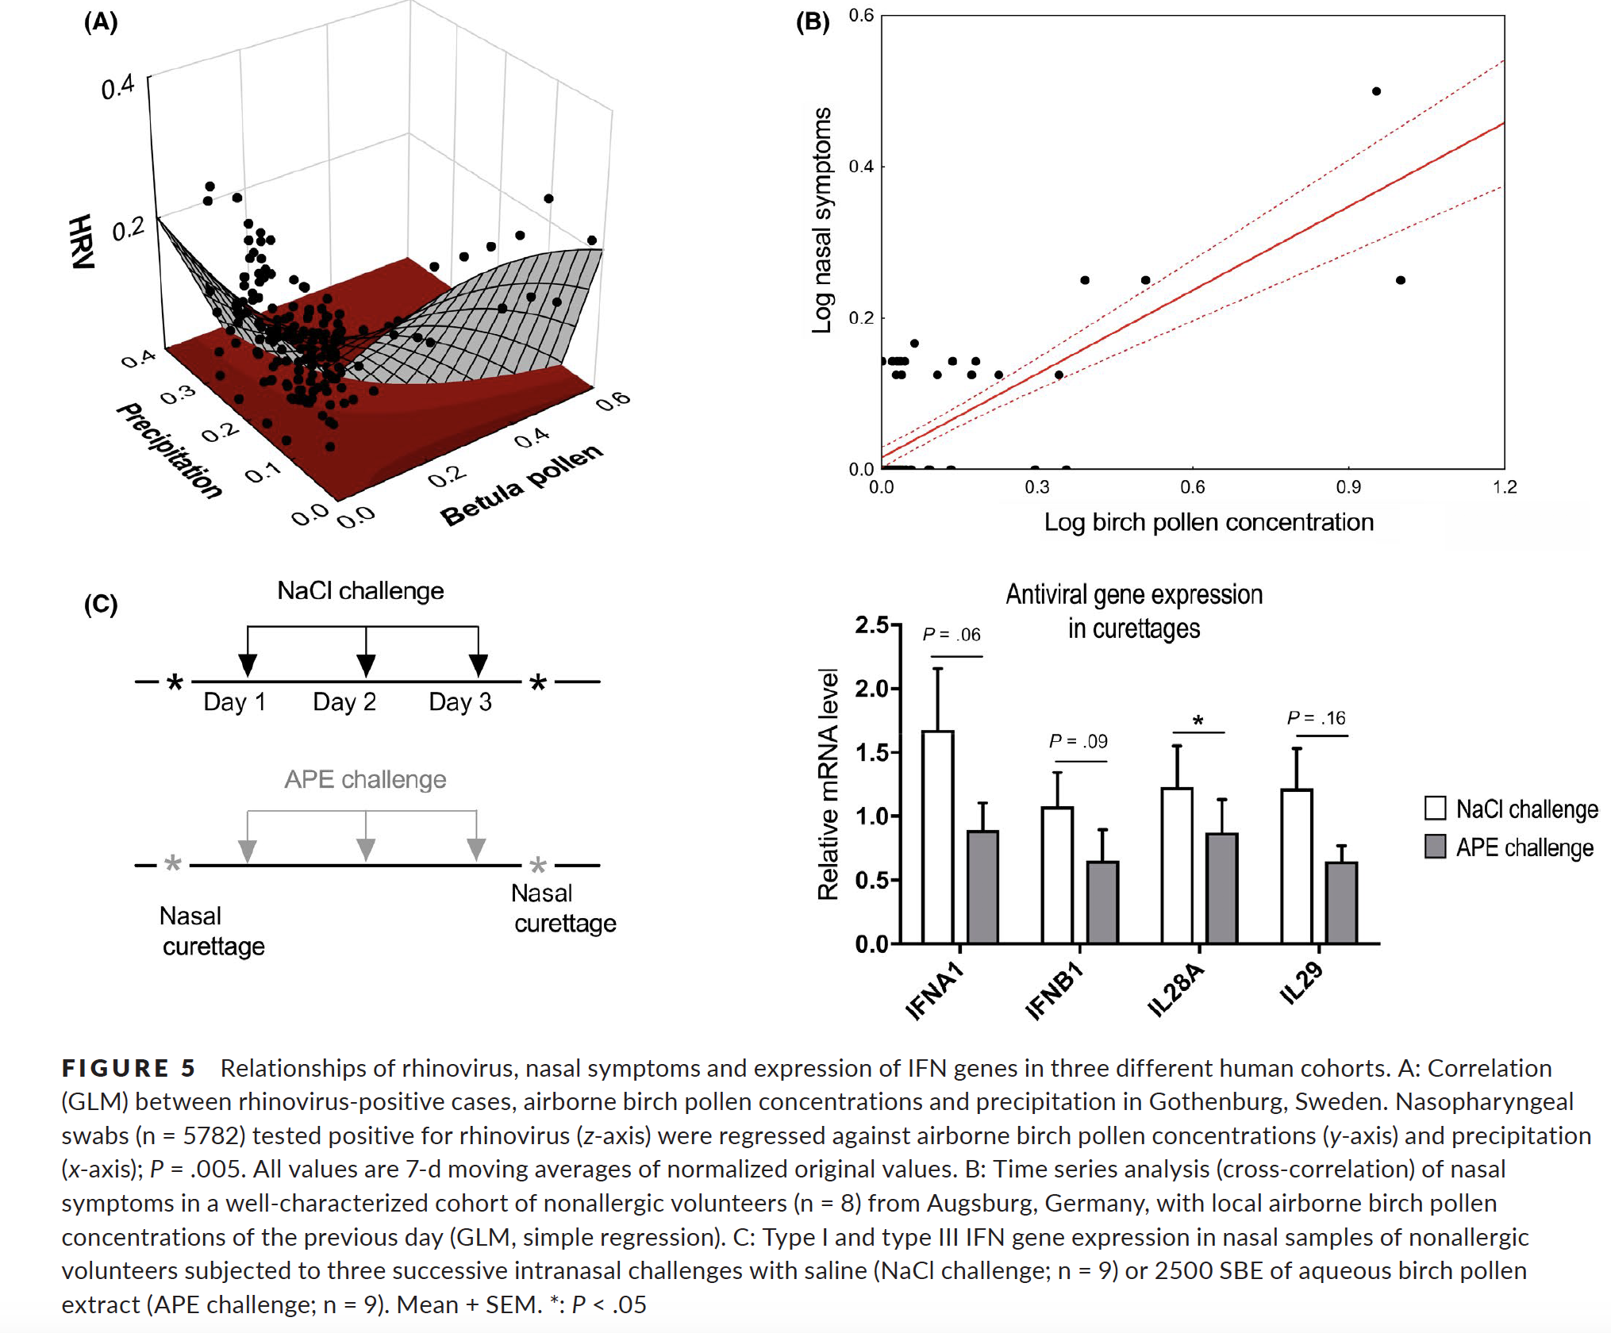

Slide 17
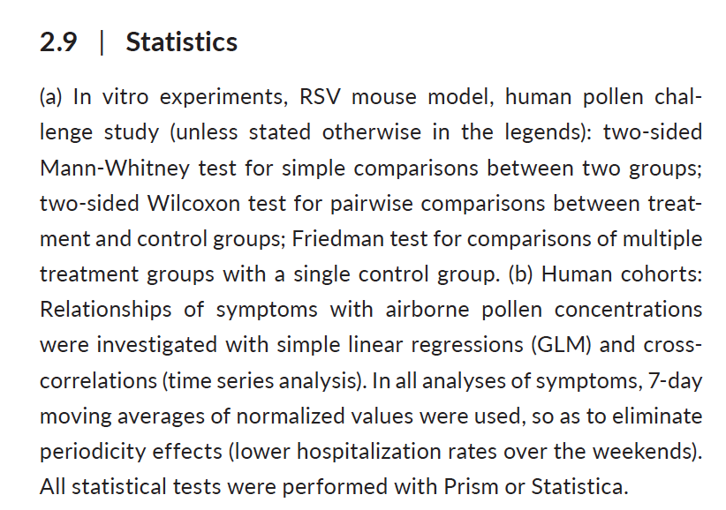
109 words!

Slide 18
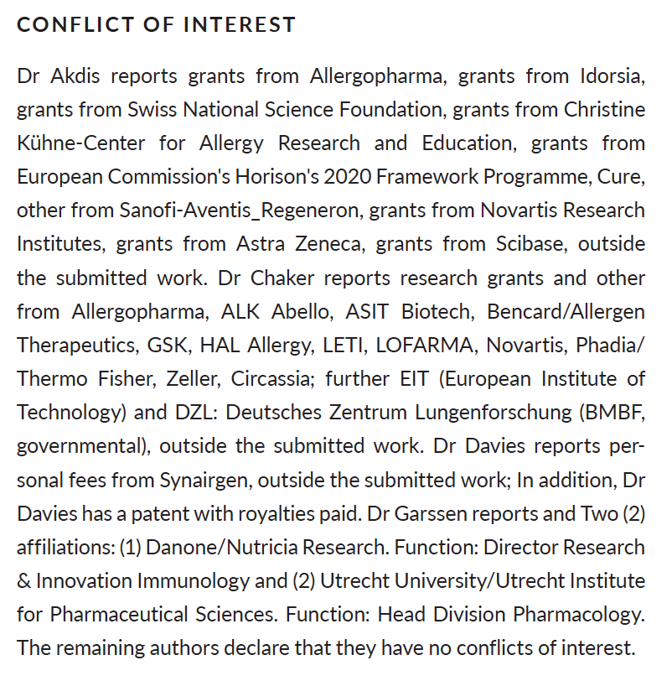
166 words!

Slide 19
109/166 * 100 = 65.7%
Authors used 65.7% of the words they used describing conflicts of interest to discuss their statistical process
In a study that combines 5 methodologically distinct separate studies
Human cells in vitro, mouse model, big epidemiology study, 8 nonallergic rhinitis cohort, and experimental pollen challenge

Slide 20
Suggestion for reproducible science
Spend at least as much time on your statistical methods section as you do on your conflicts of interest

Slide 21
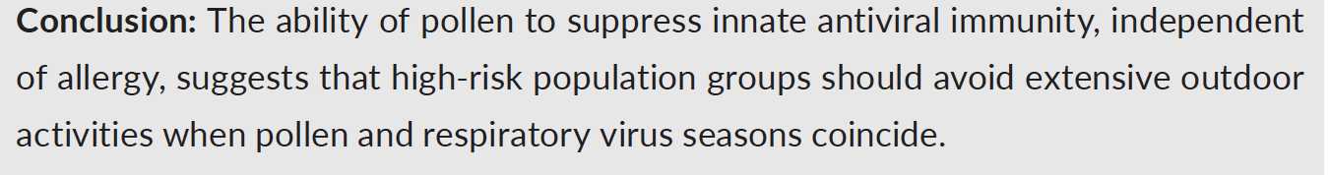
Summary
There is some evidence that pollen may dampen innate immune response to viral infections
Well done study from basic science perspective
Would need to explore these associations further with a larger, more statistically rigorous study
Authors’ conclusion is overstated:

